Slide 1
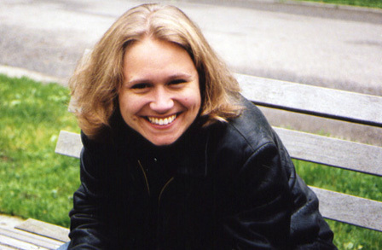
Cynthia Rylant
Connor Langston, Rachel Ewart, Caroline Gautreau & Carley Roberts

Slide 2
“And I love being a writer because I want to leave something here on earth to make it better, prettier, stronger. I want to do something important in my life, and I think that adding beauty to the world with books … really is important. Every person is able to add beauty, whether by growing flowers, or singing, or cooking luscious meals, or raising sweet pets. Every part of life can be art. I am so grateful to be a writer. I hope every child grows up and finds something to do that will seem important and that will seem precious. Happy living and, especially, happy playing.”
- Cynthia Rylant

Slide 3
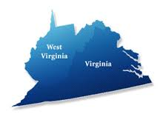
Biography - Childhood
Born on June 6, 1954 (age 59)
Born in Virginia
Parents divorced -->moved to West Virginia with her grandparents
Grew up on a large coal-mine
Loved school
Loved growing up in the mountains -->inspired many books

Slide 4
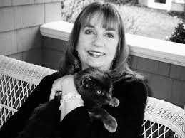
Biography - Adulthood
Graduated from Marshall University
She never thought she’d be a writer
She has a son
Moved to Ohio as an adult
Has two cats -->Benjamin and Boris
Later, moved to Oregon --> decided to paint
Dog Heaven was the first book she painted by herself
Has also lived on an island which inspired her
LOVES animals → animal rights activist
Nature lover

Slide 5
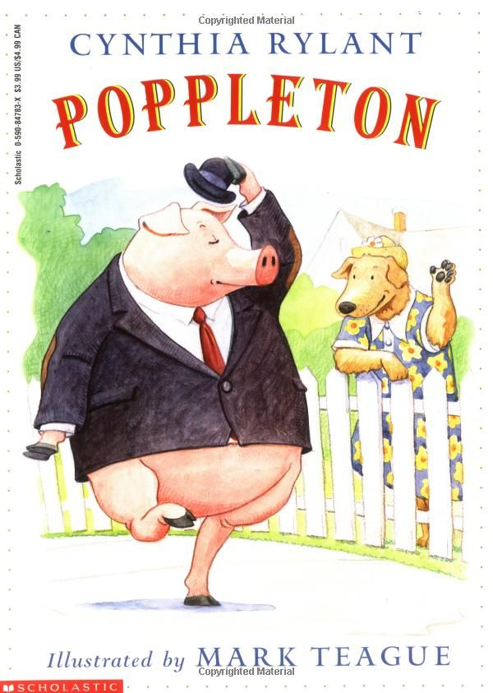
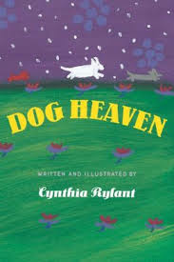
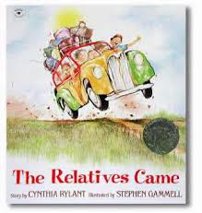
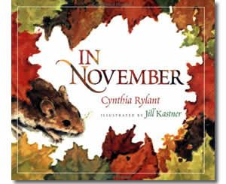
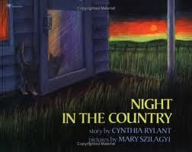
Book List
http://www.cynthiarylant.com/
-->CLICK ON CYNTHIA’S BOOKS

Slide 6
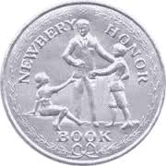
Awards/Recognition/Nominations
Caldecott Honor Book
ALA Notable Book
American Bookseller Pick of the Lists
Boston Globe-Horn Book Award
Newberry Medal
Parent’s Guide to Children’s Media Award Winner
Oppenheim Toy Portfolio Gold Award
Parent’s Choice Storybook Recommendation
National Book Award for Children’s Books

Slide 7
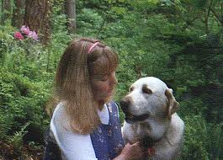
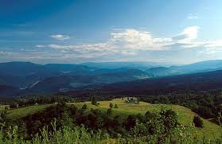
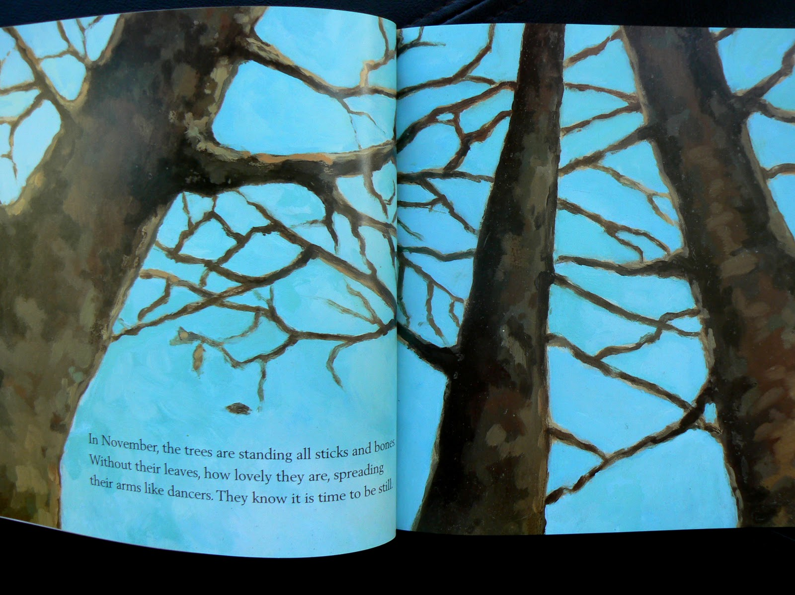
Trends
Animals
Family
Grandparent influence
Nature
Typically different illustrator
Food
Appalachia

Slide 8
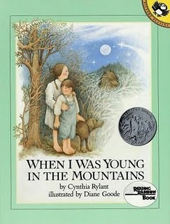
When I Was Young In The Mountains
This book includes many of the trends that are typical of her style. It’s about living with her grandparents in the mountains when she was young. She talks of the things she did during the day such as what she ate and what she did for fun. It’s a reminiscent look at her childhood and how she would have never changed it for the world.

Slide 9
Curriculum Connections
Money unit – Students will use math to count money used in the grocery store in the book.
Writing prompt – Students will write about what their day to day routine would look like if they lived in the mountains like the girl in the story.
Science – Students will classify each animal listed in the book and tell whether it is a mammal, reptile, amphibian, etc.

